Slide 1
SWE 4701
Software Metrics and Process
Lec - 5

Slide 2
Effort Estimation

Slide 3
The State of Estimation: Why Projects Fail
Common causes:
  Specifying incomplete or unclear requirements
  Failing to adjust schedules when scope changes (Too much work)
  Setting development schedules that are too aggressive (Too little time)
  Insufficient resources (Not enough people/equipment)
The root causes are often behavioral and process-oriented:
  Target vs. Estimate: Confusing the "business need" date with a rational delivery plan.
  Hope-based Planning: Developers providing the "right answer" that management wants to hear.
  Communication Gaps: Software personnel cannot credibly support their estimates.
  Quality "Surprises": Spending up to 50% of the project in "test-and-fix" cycles due to rushed, poor-quality code.

Slide 4
SOFTWARE ESTIMATION METHODOLOGIES
Estimation methods generally follow a Meta-Model: First, estimate Size, then adjust for Complexity, and finally apply a Productivity Factor.
For example, if we define
Effort = (Size × Complexity Factor) ÷ Productivity Factor
Size = 200 LOC
Complexity factor = 1.5 so we will have 200 × 1.5 = 300 complex LOC
If Productivity = 50 LOC/day then 300 ÷ 50 = 6 days of effort will be required.
Method | Description | Pros/Cons
Expert Opinion | Based on decomposition (Work or System). | Pros: Accurate with true experts. Cons: Subjective and hard to defend.
Analogy | Comparing the new project to completed "analogs." | Pros: Most accurate if they are similar. Cons: Requires a robust historical database.
Proxy Points | Uses external features (Function Points, Use Cases) as size proxies. | Pros: Objective. Cons: Requires specialized counting knowledge.
Benchmark Data | Dividing estimated size (LOC/FP) by delivery rates. | Pros: Very fast Cons: Must be used with extreme caution.
Algorithmic | Mathematical models (COCOMO) using "cost drivers." | Pros: Consistent. Cons: Only as good as the input parameters.

Slide 5
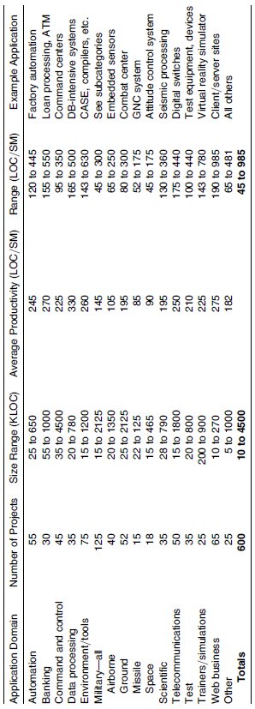

Benchmark Data
An extremely simple method of estimation, which we call the EZ estimation model
Lines of Code Benchmark Data
You are in a military ground project. You have estimated the size of your program to be 150 KLOC. What do you estimate the effort to be?
Average productivity is 195 LOC per staff month
Effort required is 150K/195 = 0.77K staff months = 770
staff months.

Slide 6
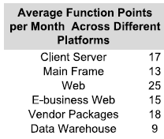
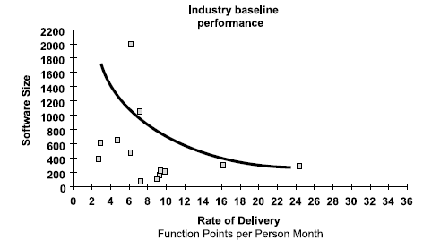
Benchmark Data
Function Point Benchmark Data
You need to build a system having an estimated 500 FPs. You need to generate an effort estimate in the next hour for a meeting. All you have are the benchmark data as provided below. What do you estimate? It will be written in Java (25%), PowerBuilder (50%), and SQL (25%), and is an E-business application. Note: the percentages are based on the size in FPs, not LOC.
Using the industry baseline performance, we can get a productivity of 14 FPs per staff month. Therefore, you have an effort of 500/14 =36 staff months.
Using the FPs by platform type, we can get productivity of 15 FPs per month. Therefore, you have an effort of 500/15 = 33 staff months.
Using the gearing factors from previous lecture, we decide to use 60 LOC per FP for Java, 30 for Powerbuilder, and 40 for SQL.
Using the LOC productivity chart, we can decide to use 275 LOC per staff month. Therefore, the system will take 20000/275 = 73 staff months.
125 FPs in Java = 60 * 125 =7.5 KLOC
125 FPs in SQL =125 * 40 = 5.0 KLOC
250 FPs in Powerbuilder= 250 * 30 = 7.5 KLOC
We will have a total of 20.0 KLOC.
it looks to be between 33 and 75 staff months or
3 and 6 staff years

Slide 7

Proxy Point Estimation
Generally used proxy point are:
  Function Points: The initial and most widely known proxy point method.
  Object Points: Used with COCOMO II—object points are screens, reports, and 3GL objects
  Use Case Points: Second generation proxy point based on use cases. Use case points has had excellent results and is used in industry today.

Slide 8
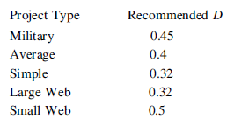
Proxy Point Estimation
Function Points:
Project Duration: The length of a project in calendar months equals the number of FP raised to the Dth power, where D ranges from 0.32 to 0.5. The recommended values of D are as follows
Staffing: The number of staff on a new development project equals the number of function points divided by 150. The number of staff on a maintenance project equals the number of function points divided by 750.
Effort: The number of staff months on a project equals the number of people multiplied by the duration.
Creeping Features: The number of user requirements will increase at a rate of 1% to 5% per month from the design through coding phases, based on the development methodology. The average is 2%.

Slide 9
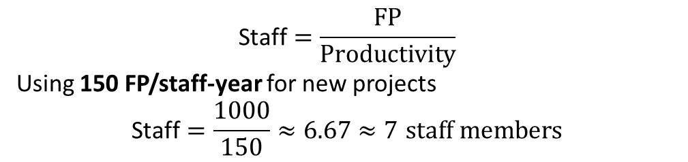


Proxy Point Estimation
Function Points:
Assume that you have a new, 1000 FP military project. What is the estimate for effort, staffing, and duration? Assume design through coding is 50% of the schedule.
Duration
Effort
$$\text{Duration}\text{ (}\text{months}\text{)}={\text{FP}}^{D}$$
For a military project: $D=0.45$
So
$${1000}^{0.45}≈22.4 \text{months}≈2 \text{years}$$
$$\text{Effort}=\text{Staff}×\text{Duration}\text{ (}\text{years}\text{)}$$
$$7×2=14 \text{staff}\text{−}\text{years}$$
Creeping Features
Design-through-coding phase = 50% of schedule So 22.4 × 50% = 11.2 months
Requirements growth = 2% per month during this phase which is 11.2 × 2% = 22.4% total growth
This is often calculated as a 25% increase in total effort for a ~22% Original Effort: 14 staff-years.
Added Effort (25% of original): 14 *0.25 = 3.5 staff-years.
Staffing
$$\text{Staff}=\frac{\text{FP}}{\text{Productivity}}$$
Using 150 FP/staff-year for new projects
$$\text{Staff}=\frac{1000}{150}≈6.67≈7 \text{staff} \text{members}$$

Slide 10
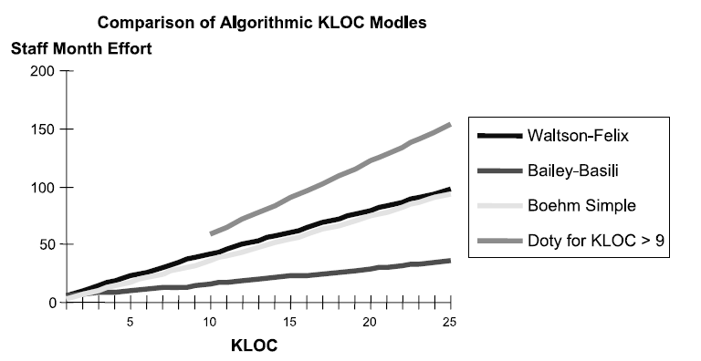
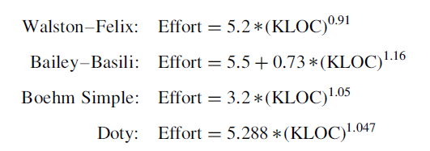
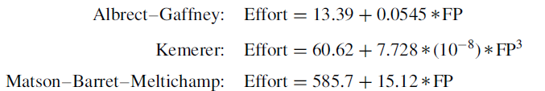
Algorithmic Models
The algorithmic models are empirically derived, using regression analysis
The typical manual, algorithmic model is of the form Effort = A + B (Size)^{C}, where A, B, and C are empirically determined constants, and Size is the length in either LOC or FPs.
There are many different KLOC equations for effort
There are few FP equations available for effort

Slide 11
COCOMO
COCOMO is a static single variable model
is the most widely used software estimation model.
The COCOMO model predicts the effort and duration of a project based on inputs relating to the size of the resulting systems and a number of "cost drives" that affect productivity.
COCOMO is an acronym for Constructive Cost Model that was developed by Barry Boehm
The COCOMO models are defined for three classes of software projects.
    (1) organic mode
    (2) semi-detached mode
    (3) embedded mode

Slide 12
Project Types/Levels of COCOMO
The level of difficulty was broken into three modes
Organic Mode
  Constraints on development are mild. Many similar projects previously developed by the organization
  Relatively small, simple software projects in which small teams with good application experience work to a set of less than rigid requirements (e.g., a thermal analysis program developed for a heat transfer group)
Semi-detached Mode
  More constraints on development, but some flexibility remains. Few similar projects previously developed by the organization
  An intermediate (in size and complexity) software project in which teams with mixed experience levels must meet a mix of rigid and less than rigid requirements (e.g., a transaction processing system with fixed requirements for terminal hardware and data base software)
Embedded Mode
  Very tight constraints. No similar projects previously developed
  A software project that must be developed within a set of tight hardware, software and operational constraints (e.g., flight control software for aircraft).
Notes:
Organic Mode: The project is developed in a familiar, stable environment, and the product is similar to previously developed products. The product is relatively small, and requires little innovation.
Semidetached Mode: The project's characteristics are intermediate between Organic and Embedded.
Embedded Mode: The project is characterized by tight, inflexible constraints and interface requirements. An embedded mode project will require a great deal of innovation.

Slide 13
COCOMO models
Aspects | Organic | Semidetached | Embedded
Project Size | 2 to 50 KLOC | 50-300 KLOC | 300 and above KLOC
Complexity | Low | Medium | High
Team Experience | Highly experienced | Some experienced as well as inexperienced staff | Mixed experience, includes experts
Environment | Flexible, fewer constraints | Somewhat flexible, moderate constraints | Highly rigorous, strict requirements
Effort Equation | E = 2.4(Size in KLOC)^{1.05} | E = 3.0(Size in KLOC)^{1.12} | E = 3.6(Size in KLOC)^{1.20}
Example | Simple payroll system | New system interfacing with existing systems | Flight control software

Slide 14
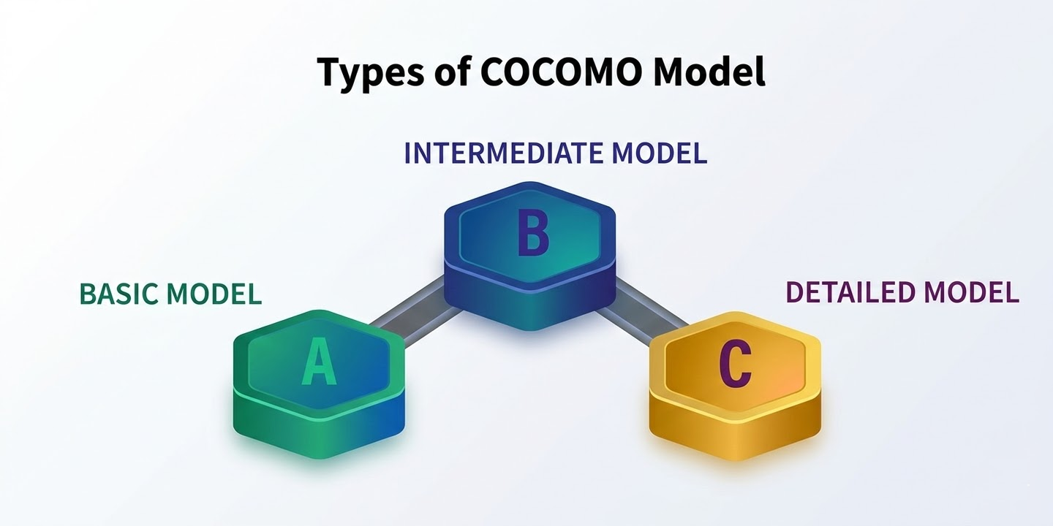
COCOMO models

Slide 15
Effort Computation
The Basic COCOMO model computes effort as a function of program size. The Basic COCOMO equation is:
E = a *(Size in KLOC)^{b}
Effort for three modes of Basic COCOMO.
Mode | a | b
Organic | 2.4 | 1.05
Semi-detached | 3.0 | 1.12
Embedded | 3.6 | 1.20

Slide 16

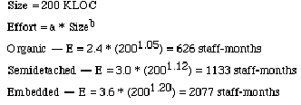
Example

Slide 17
Basic COCOMO Estimations
The Basic COCOMO formula for effort estimation is:
Effort (E) = a * (KLOC)^b
The estimated development time (T) is given by:
T = c * (E)^d
The constant values a, b, c, and d for the Basic Model for the different categories of the software projects are:
Software Projects | a | b | c | d
Organic | 2.4 | 1.05 | 2.5 | 0.38
Semi-Detached | 3.0 | 1.12 | 2.5 | 0.35
Embedded | 3.6 | 1.20 | 2.5 | 0.32

Slide 18
Exercise
Suppose that a Basic project was estimated to be 400 KLOC (kilo lines of code). Calculate effort and time for each of the three modes of development.
For organic mode,
  effort = 2.4 × (400)^{1.05} ≈ 1295 person-month.
  dev. time = 2.5 × (1295)^{0.38} ≈ 38 months.
For semi-detach mode,
  effort = 3 × (400)^{1.12} ≈ 2462 person-month.
  dev. time = 2.5 × (2462)^{0.35} ≈ 38 months.
For Embedded mode,
  effort = 3.6 × (400)^{1.20} ≈ 4772 person-month.
  dev. time = 2.5 × (4772)^{0.32} ≈ 38 months.
Software Projects | a | b | c | d
Organic | 2.4 | 1.05 | 2.5 | 0.38
Semi-Detached | 3.0 | 1.12 | 2.5 | 0.35
Embedded | 3.6 | 1.20 | 2.5 | 0.32

Slide 19
Intermediate COCOMO Model
The Basic COCOMO model estimates effort mainly using Lines of Code (LOC) and predefined constants.
It assumes effort depends only on program size, which is often unrealistic.
In real software projects, many other factors influence development effort and schedule.
Examples of influencing factors:
  Required software reliability
  Developer experience
  Team capability
  Project complexity
These influencing factors are called Cost Drivers (multipliers).
The Intermediate COCOMO model improves estimation by including these additional factors.
It uses 15 cost drivers to adjust the effort estimate.
Each cost driver increases or decreases the final effort calculation depending on project conditions.

Slide 20
Intermediate COCOMO Model
Product attributes
Hardware attributes
Required Software Reliability extent
Size of the application database
The complexity of the product
Run-time performance constraints
Memory constraints
The volatility of the virtual machine environment
Required turnabout time
Cost Drivers
Personal attributes
Project attributes
Analyst capability
Software engineering capability
Application experience
Virtual machine experience
Programming language experience
Use of Software Tools.
Application of Software Engineering Methods.
Required development schedule.

Slide 21
Intermediate COCOMO Model
The effort estimation formula is:
Effort = a * (KLOC)^b * EAF
Where:
  EAF (Effort Adjustment Factor) accounts for different cost drivers.
  ‘a’ and ‘b’ remain constants based on the project type.
The estimated development time (T) is given by:
T = c * (E)^d
The constant values a, b, c, and d for the intermediate Model for the different categories of the software projects are:
Software Projects | a | b | c | d
Organic | 3.2 | 1.05 | 2.5 | 0.38
Semi-Detached | 3.0 | 1.12 | 2.5 | 0.35
Embedded | 2.8 | 1.20 | 2.5 | 0.32
How to calculate the EAF?

Slide 22

Intermediate COCOMO Model
Effort Adjustment Factor
The Effort Adjustment Factor (EAF) is determined by multiplying the effort multipliers associated with each of the 15 attributes.
For each of these 15 drivers, you must assign a rating based on your specific project environment. These ratings typically range from Very Low to Extra High.
Each rating corresponds to a specific numerical value (multiplier) defined in the COCOMO standard tables.
A Nominal rating always has a value of 1.00 (meaning it has no effect on the effort).
Ratings like Very Low might be 0.75 (reducing effort), while Extra High might be 1.50 (increasing effort).
Example:
If all your drivers are "Nominal" (1.00) except for two:
High Reliability (RELY): 1.15
High Analyst Capability (ACAP): 0.86 (High capability reduces effort)
Your EAF would be:

Slide 23
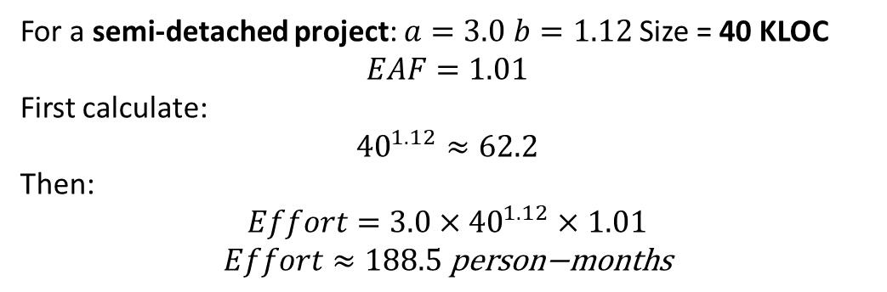

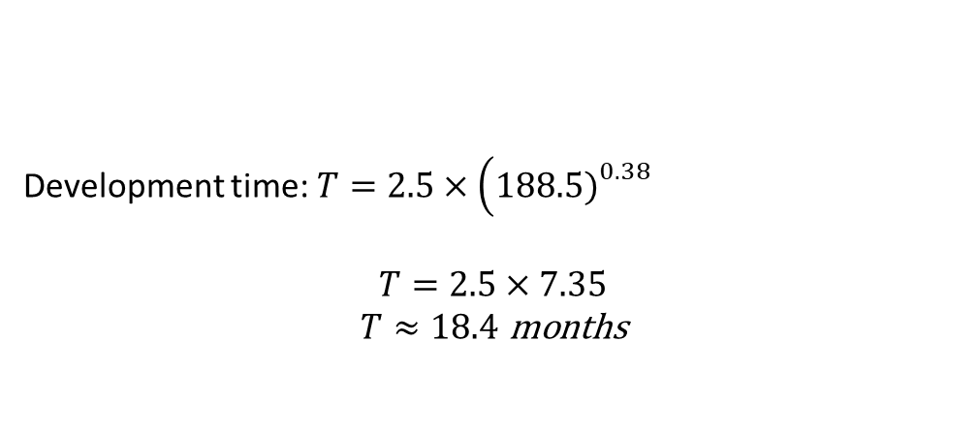
Example
A software organization is developing a semi-detached software system with an estimated size of 40 KLOC (thousand lines of code). The project manager decides to use the Intermediate COCOMO model to estimate the development effort. The following cost drivers are identified for the project:
Calculate the Effort Adjustment Factor (EAF) for the project.
Estimate the total development effort (in person-months) using the Intermediate COCOMO model.
Estimate the development time (in months) and the average staffing required for the project.
Cost Driver | Multiplier
Required Software Reliability (RELY) | 1.15
Product Complexity (CPLX) | 1.10
Programmer Capability (PCAP) | 0.88
Use of Software Tools (TOOL) | 0.91
For a semi-detached project: $a=3.0$ $b=1.12$ Size = 40 KLOC
$$EAF=1.01$$
First calculate:
$${40}^{1.12}≈62.2$$
Then:
$$Effort=3.0×{40}^{1.12}×1.01$$
$$Effort≈188.5 \text{person}\text{−}\text{months}$$
EAF is the product of all cost driver multipliers.
$$EAF=1.15×1.10×0.88×0.91$$
Development time: $T=2.5×\left(188.5{\left.)\right.}^{0.38}\right.$
$$T=2.5×7.35$$
$$T≈18.4 \text{months}$$

Slide 24
Detailed COCOMO
adds phase-wise effort distribution and considers cost drivers per phase.
All the calculations are similar to the intermediate model.
The constant values a, b, c, and d for the detailed Model for the different categories of the software projects are:
Software Projects | a | b | c | d
Organic | 2.4 | 1.05 | 2.5 | 0.38
Semi-Detached | 3.0 | 1.12 | 2.5 | 0.35
Embedded | 3.6 | 1.20 | 2.5 | 0.32
Once the total effort is calculated, it’s distributed across software life cycle phases:
Phase | % of Effort (Organic) | Semi-detached | Embedded
Requirements | 6% | 7% | 8%
System Design | 16% | 13% | 10%
Detailed Design | 26% | 25% | 24%
Coding & Unit Testing | 42% | 42% | 43%
Integration & Testing | 16% | 15% | 15%

Slide 25
Example
Suppose we have a semi-detached project estimated to be 50 KLOC, with an EAF of 1.2.
Effort calculation
Effort = a × (KLOC)^b × EAF
= 3.0 × (50)^1.12 × 1.2
≈ 281.9 Person-Months
Phase-wise Effort (Semi-detached)
Phase | % Effort | Person-Months
Requirements | 7% | 19.7
System Design | 13% | 36.6
Detailed Design | 25% | 70.5
Coding & Unit Testing | 42% | 118.4
Integration & Testing | 15% | 42.3
Total | 100% | 281.9
Development Time
TDEV = c × (Effort)^d
  = 2.5 × (281.9)^0.35
  ≈ 17.1 months

Slide 26
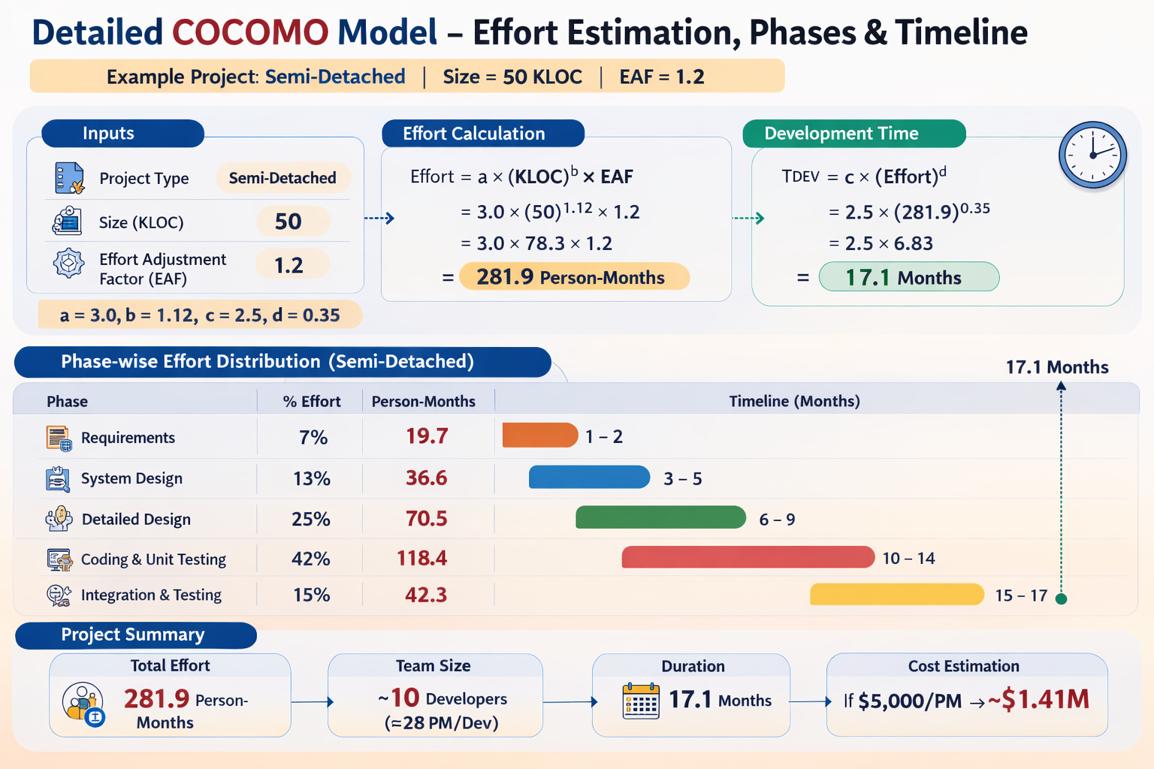
Example

